Slide 1
MESAJ KUYRUKLARI

Slide 2
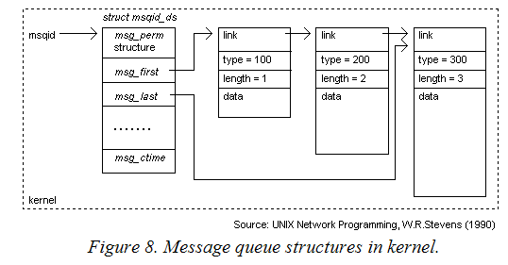
Mesaj Kuyruk Yapıları

Slide 3
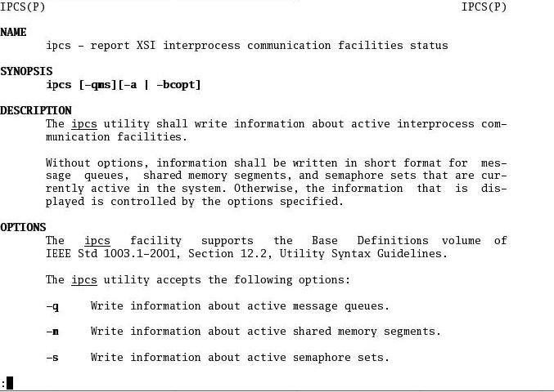
IPCS

Slide 4

msgcreate.c
#include <stdio.h>
#include <stdlib.h>
#include <sys/types.h>
#include <sys/ipc.h>
#include <sys/msg.h>
#include <unistd.h>
#include <signal.h>
#include <string.h>
/**********************msgcreate.c***************/
#define KEY 56
int main()
{
int mqid;
mqid = msgget(KEY, IPC_CREAT|0777);
}
key_t ftok(const char *path, int id);
#include <sys/msg.h>
key = ftok("/home/yusuf/dosyaadi", 'b');
msqid = msgget(key, 0666 | IPC_CREAT);

Slide 5

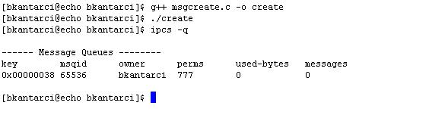
IPCS & msgcreate.c

Slide 6

msgrmid.c
/***************msgrmid.c****************/
int main(int argc, char **argv)
{
int c, oflag, mqid;
char *end="\0";
c=strtol(argv[1],&end,10);
printf("queue num %s %d\n",argv[1],c);
mqid = msgctl(c, IPC_RMID,0);
}
Kuyruğu silmek için:
ipcrm

Slide 7
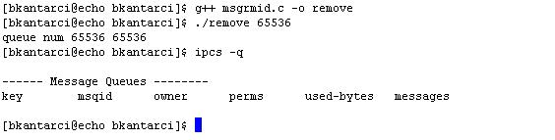
msgrmid.c

Slide 8

msgsnd.c
/**********************msgsnd.c**********************/
typedef struct mm{
long mesg_type;
char mesg_data[256];
}Mesg;
int main(int argc, char **argv)
{ char *end="\0";
int mqid;
Mesg msg;
mqid=strtol(argv[1],&end,10);
msg.mesg_type=strtol(argv[2],&end,10);
strcpy(msg.mesg_data,argv[3]);
msgsnd(mqid,(char *)&msg,256,IPC_NOWAIT);
}

Slide 9
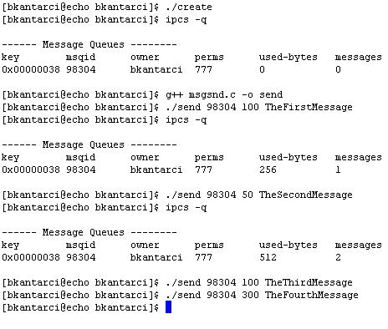
msgsnd.c

Slide 10
msgrcv.c
/**********************msgrcv.c**********************/
typedef struct mm{
long mesg_type;
char mesg_data[256];
}Mesg;
int main(int argc, char **argv)
{ char *end="\0";
int mqid;
long type;
Mesg msg;
mqid=strtol(argv[1],&end,10);
type=strtol(argv[2],&end,10);
printf("Type=%ld mqid=%ld\n",type,mqid);
msgrcv(mqid,(char *)&msg,256,type,IPC_NOWAIT);
printf("Mess received:%s type=%ld\n",msg.mesg_data,msg.mesg_type);
}

Slide 11
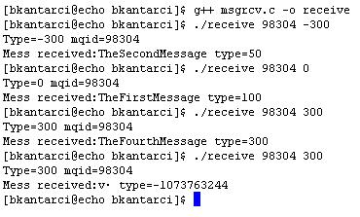
msgrcv.c
Dikkat: msgtype<0 verilmişse, mesaj kuyruğunda |msgtype|’a eşit veya ondan küçük olmak kaydıyla, en küçük type değerine sahip mesaj kuyruktan çekilir.

Slide 12
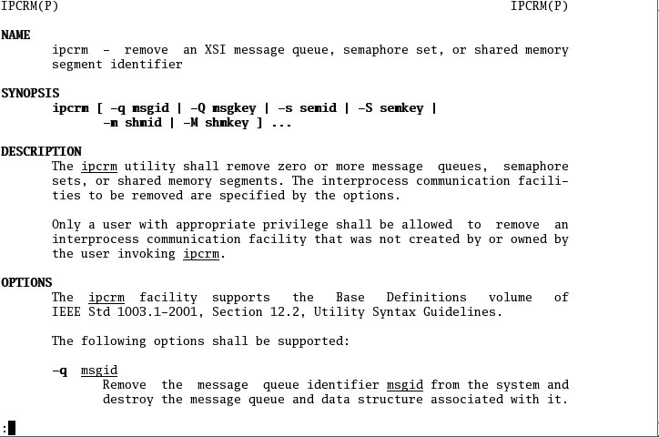
IPCRM

Slide 13
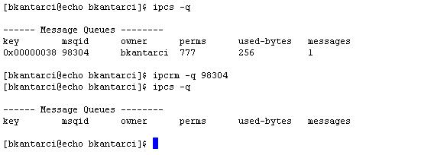
IPCRM

